Slide 1
Embedded Software Development Tools
Er. साहित बराल July 5/2022

Slide 2
Embedded Software Development Tools and Processes Hardware & Software
Hardware – Host development system
Software – Compilers, simulators etc.
Target systems ◻ PC or similar with I/O cards ◻ PC or similar with custom I/O ◻ COTS(Commercial of the Shelf) boards ◻ Custom designed boards, interfaces etc.

Slide 3
Host and Target Machine
Application programs are typically developed, complied, and run on host system
Host is computer system on which all programming tools are run
Once programmed has been written, complied, assembled and linked, it is moved to target
Software Development Native Compiler – Host and Target same uP Cross Compiler – Host develops code for a different target uP

Slide 4
Programming Embedded Systems
Target hardware platform is different from development platform - Development platform, called the Host computer (General purpose computer) - Host computer runs compiler, assembler, Linker, locator to create a binary image that will run the target embedded system

Slide 5
Programming Embedded Systems
Embedded Systems Programming requires a more complex software build process - Target hardware platform consists of - Target hardware (processor, memory, I/O) - Runtime environment (Operating System/Kernel) deployment - Target hardware platform contains only what is needed for final deployment - Target hardware platform does not contain development tools (editor, compiler, debugger)

Slide 6
Process for Developing Embedded Software
To develop software for a General Purpose Computer - Create source file - Type in C code - Build: compile and link - Execute: load and run

Slide 7
Process for Developing Embedded Software
To develop software for an embedded system - Create source file (on Host) - Type in C code (on Host) - Compile/Assemble: translate into machine code (on Host) - Link: combine all object files and libraries, resolve all symbols (on Host) – - Locate: assign memory addresses to code and data (on Host) - Download: copy executable image into Target processor memory - Execute: reset target processor

Slide 8
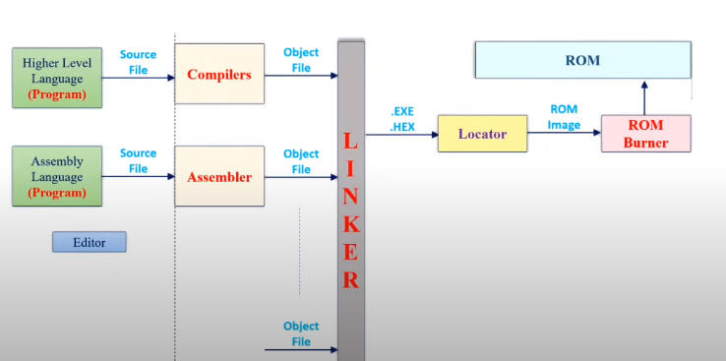
Embedded software development

Slide 9
Embedded Tools
Editor
Compiler
Assembler
Linker and Locator
Debugger
Emulator
Simulator
Downloader
Profiler
Integrated Development Environment (IDE)

Slide 10
Editor
The very first tool in the development of software for an embedded system is a text editor
Editor is used to writing code for embedded system applications
The code is written in programming language
Instruction are stored in memory as ASCII form

Slide 11
Compiler
Machine language : 1010 1100
Compiling Embedded Systems Compiler translates program written in human-readable language into machine language - Source Code --> Object file - Object file is binary file that contains set of machine-language Instructions (opcodes) and data resulting from language translation process
Machine-language instructions are specific to a particular processor
A Native-compiler runs on a computer platform and produces code for that same computer platform
A Cross-compiler runs on one computer platform and produces code for another computer platform

Slide 12
Assembler
Assembly language : MOV A, R0
An Assembler is software program that converts source code written in assembly language into machine language.
The input to the Assembler must be assembly language
An Assembler that runs on Host but produces binary instruction appropriate for Target.

Slide 13
Linker and Locator
A linker or link editor is a program that takes one or more objects generated by compilers and assembles them into a single executable program or a library that can later be linked to in itself
All of the object files resulting from compiling must be combined in a special way before the program can be executed

Slide 14
Linker and Locator
A Locator is the tool that performs the conversion from relocatable program to executable binary image
It will produce an output file that contains a binary images that can be loaded into the target ROM
You will have to provide information about the memory on the target board as input to the locator
The locator uses this information to assign physical memory addresses to each of the code and data sections

Slide 15
Debugger
Software Now that the software has been downloaded to the target processor, how do we know if it is working?
Run-time errors are not as obvious - Most embedded systems do not have a "screen" - When a program fails, usually causes the processor to crash or lock-up
Logic errors - If program runs, is it performing the correct steps?

Slide 16
Debugger
A debugger or debugging tool is a computer program that is used to test and debug other programs.
The code to be examined might alternatively be running on an instruction set simulator .
When the program crashes, the debugger shows the actual position in the original code if it is a source-level debugger.
If it is a low-level debugger or a machine-language debugger it shows that line in the program

Slide 17
Debugging with Emulator
An emulator is a piece of Hardware/Software that enables one computer system to run programs that are written for another computer system.
For example there is a Comodore 64 emulator for the iPhone which allow you to run games that written for the iPhone.
An emulator is used on the target processor (the processor for which the program is being written).

Slide 18
Debugging with Simulator
Simulator is a piece of Hardware/Software that simulates another system.
for example a flight simulator allows you to experience what it is like to fly an aircraft, a driving simulator to experience driving etc.
Simulator tests the program on the development processor(the processor on which we are working).

Slide 19
Downloading and Executing Your Program
Once a program has been successfully compiled, linked, and located, it must be moved to the target platform
Download the binary Image to the embedded system - Executable binary image is transferred and loaded into a memory device on target board
Your program will then execute when you reset the processor, or apply power to the embedded system

Slide 20
Profiler
A Software Program that gathers information about a program during execution.
It is used to know which areas of code to optimize Speed and Memory.
Profiler may show time elapsed in each function and its descendants
number of calls , call-graph (some)

Slide 21
Integrated Development(IDE)
Integrated Development Environment Software usually consists of the debugger, complier, and a code editor
There are many integrated development environment is available in the market but your choice is dependent on the type of microcontroller and processor you are using for your development
Examples: MPLAB Xcode Eclispe Android Studio Code Blocks Adobe Flash builser

Slide 22
For reference
https://www.youtube.com/watch?v=Z--hbZmmxmA
https://www.youtube.com/watch?v=PcDWm7J19Vo

